Slide 1

Software Trends Analysis
Rithik Ganesan
4/5/2026

Slide 2



OUTLINE
Executive Summary
Introduction
Methodology
Results
Visualization – Charts
Dashboard
Discussion
Findings & Implications
Conclusion
Appendix

Slide 3

EXECUTIVE SUMMARY
The developer technology landscape is dominated by a core set of established tools such as JavaScript, PostgreSQL, AWS, and React/Node.js. These tools maintain their leading positions in both current usage and future demand across nearly 19,000 survey respondents.
A clear shift is underway in language preferences, with TypeScript, Go, and Rust gaining significant desired adoption while older languages like PHP, PowerShell, and Java are losing developer interest.
Rising tools like Supabase and Redis signal a move toward lightweight, developer-friendly data solutions.
Cloud platforms remain heavily consolidated around AWS, Azure, and Google Cloud, but there are emerging providers like Cloudflare, Hetzner, and Supabase
The survey's demographic skew toward 25–44-year-old, degree-holding developers in North America and Europe. These trends may not fully capture global or early-career developer preferences.

Slide 4

INTRODUCTION
This report analyzes Stack Overflow developer survey data from nearly 19,000 respondents to identify the most widely used and desired technologies across programming languages, databases, cloud platforms, and web frameworks.
The analysis compares current use against future demand to surface emerging trends, declining technologies, and areas of stability.
The target audience is leaders and hiring managers who need data-driven insights to guide stack selection and investment decisions.
By highlighting the gap between what developers use today and what they want to use next, this report provides actionable intelligence for organizations seeking to modernize their technology stack and remain competitive in attracting developer talent.

Slide 5

METHODOLOGY
Data Source and Collection
The data was sourced from Course Era at
Data was collected using web scraping techniques to generate Excel and CSV files
Data Wrangling
Data cleaning and processing done through identifying and imputing missing values, identifying repeat entries, normalizing data, and encoding.
https://cf-courses-data.s3.us.cloud-object-storage.appdomain.cloud/HLOosvsPgIwt5dgOOh1RSg/survey-data-updated.csv

Slide 6
Results

Slide 7
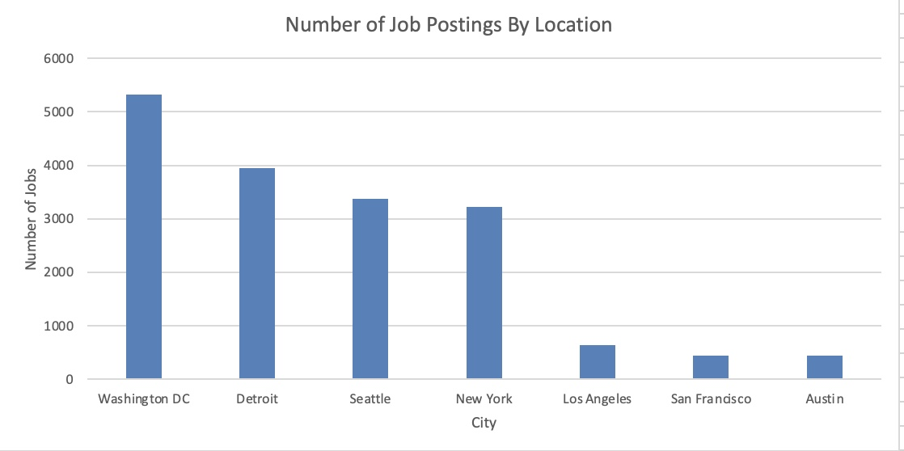
JOB POSTINGS
In Module 1 you have collected the job posting data using Job API in a file named “job-postings.xlsx”. Present that data using a bar chart here. Order the bar chart in the descending order of the number of job postings.

Slide 8
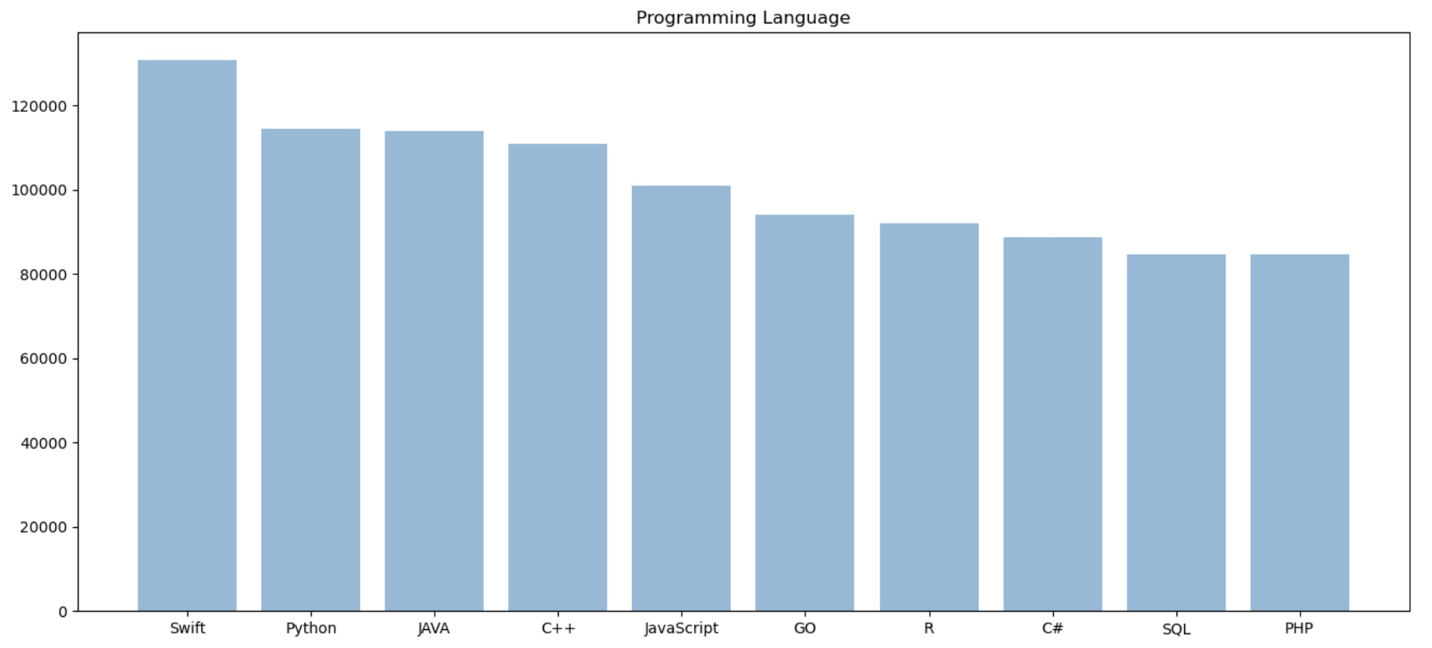
POPULAR LANGUAGES
In Module 1 you have collected the job postings data using web scraping in a file named “popular-languages.csv”. Present that data using a bar chart here. Order the bar chart in the descending order of salary.

Slide 9
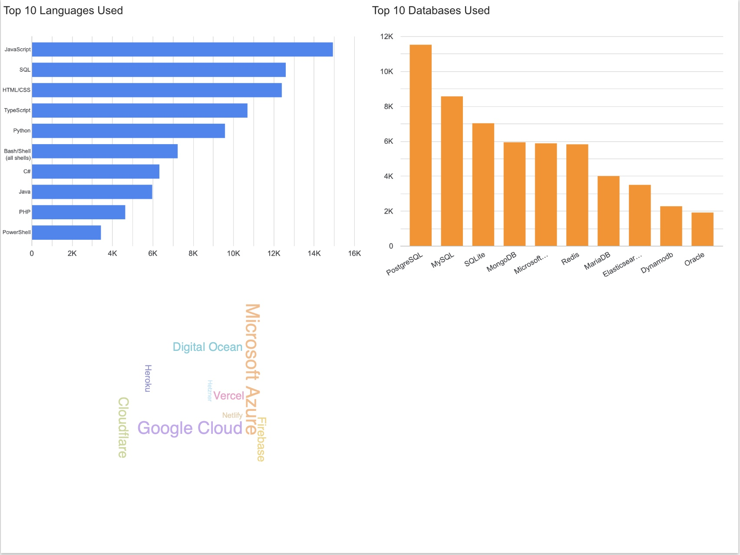
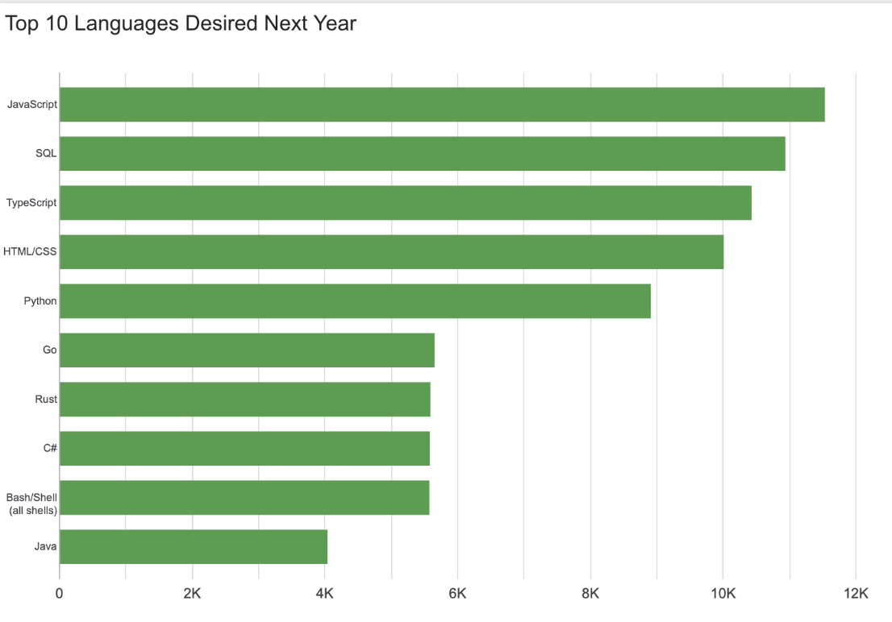
PROGRAMMING LANGUAGE TRENDS
Summarize key trends shown in the charts.
Current Year
Next Year
<Bar chart of top 10 programming languages for the current year goes here.>
< Bar chart of top 10 programming languages for the next year goes here.>

Slide 10
PROGRAMMING LANGUAGE TRENDS - FINDINGS & IMPLICATIONS
FINDINGS
JavaScript remains the most used and most desired language
TypeScript sees the largest jump, going from 4th to 3rd and nearly closing the gap with SQL and HTML/CSS.
Go and Rust enter the desired top 10, replacing PHP and PowerShell
Java drops significantly (by almost 2,000 responses)
IMPLICATIONS
The surge in TypeScript demand alongside steady JavaScript usage suggests developers increasingly want type safety. Teams should consider TypeScript adoption.
Go and Rust replacing PHP and PowerShell signals a shift toward performance focused, modern systems languages. Organizations relying heavily on PHP or PowerShell may face growing difficulty recruiting developers.
Java's decline in desirability suggests that people are eager to move on. Companies with large Java codebases should plan for modernization to keep developers happy.

Slide 11
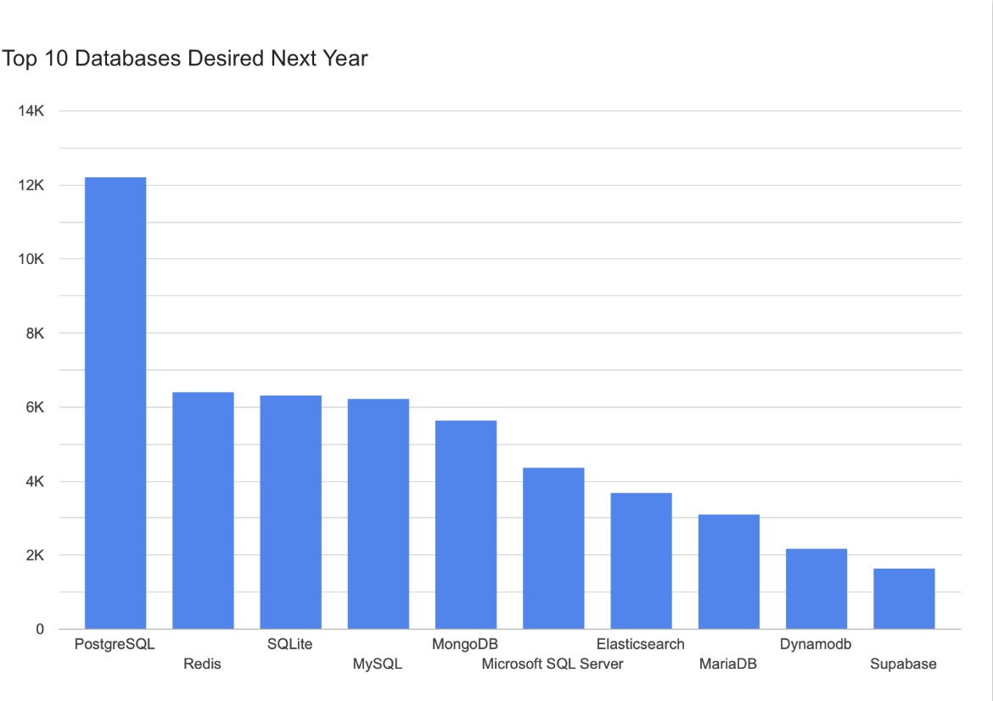
DATABASE TRENDS
Summarize key trends shown in the charts.
Current Year
Next Year
< Bar chart of top 10 databases for the current year goes here >
< Bar chart of top 10 databases for the next year goes here.>

Slide 12
DATABASE TRENDS - FINDINGS & IMPLICATIONS
FINDINGS
PostgreSQL is the clear leader in both current usage and future desire, and is the only database whose desired count actually exceeds its current usage.
Redis makes the biggest jump, rising from 6th in current usage to 2nd in desired.
Oracle drops out of the desired top 10 entirely, replaced by Supabase, a newer, open-source platform built on PostgreSQL.
IMPLICATIONS
PostgreSQL's dominance suggests it has become the default choice for new projects. Teams still using MySQL or SQL Server should evaluate PostgreSQL for future work to align with developer expectations.
Redis's surge in demand shows the growing need for caching, real-time data, and high-performance data layers in modern architectures. Investing in Redis expertise can prove valuable.
Oracle being replaced by Supabase in the desired list signals developers favoring open-source, developer-friendly tools over enterprise databases. Organizations should assess whether modern alternatives could reduce costs and improve developer satisfaction.

Slide 13

DASHBOARD

Slide 14
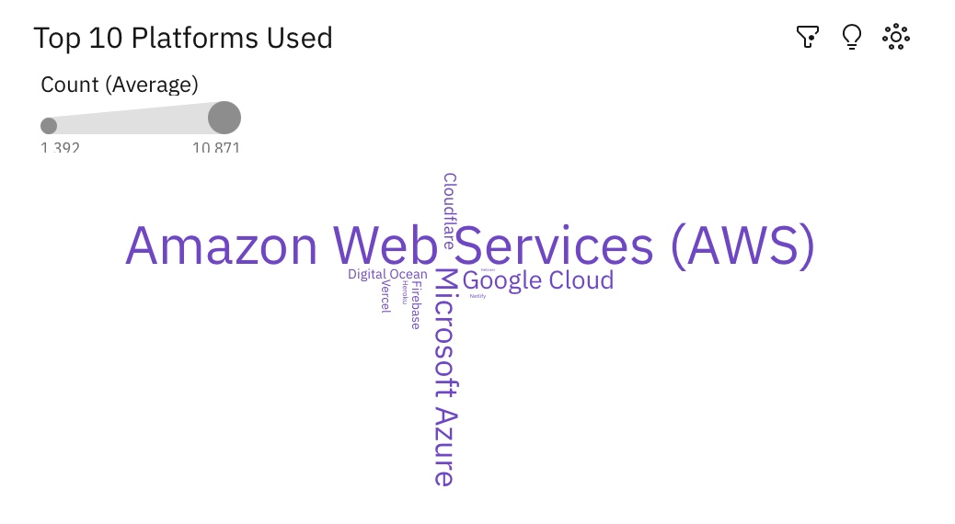
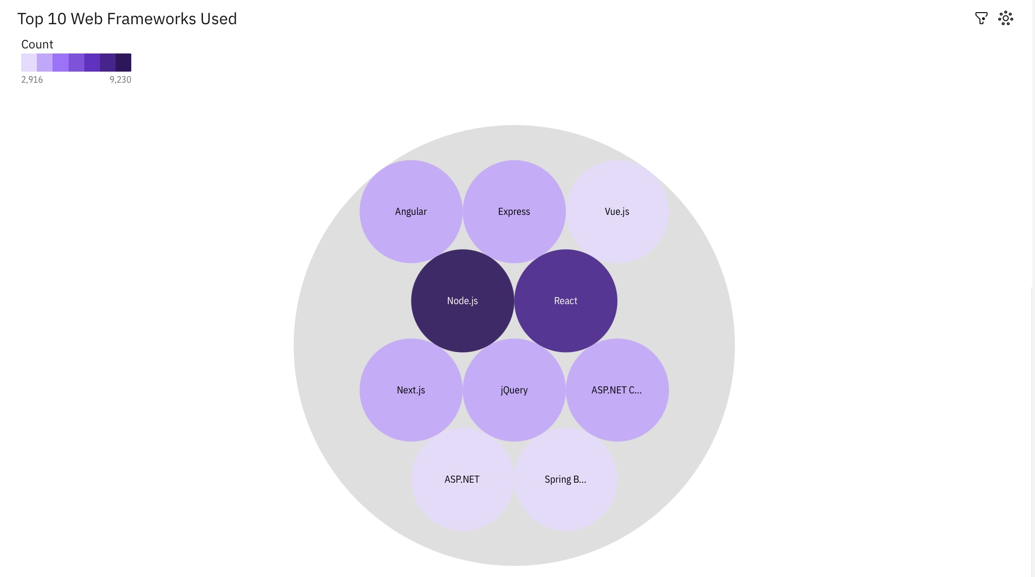
DASHBOARD TAB 1: Current Technology Usage
Screenshot of dashboard tab 1 goes here
Dashboard Insight
Summarize key insights shown

Slide 15
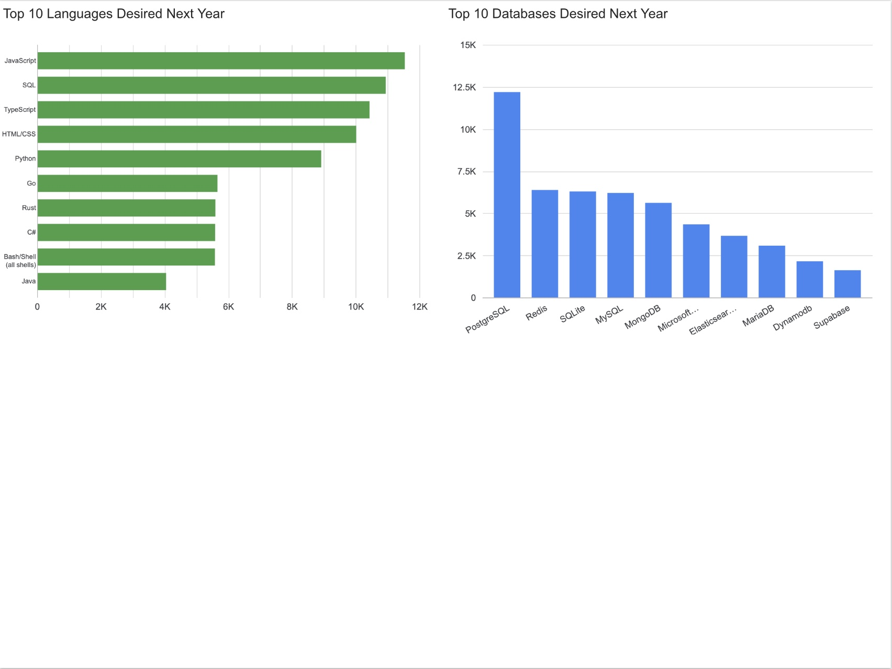
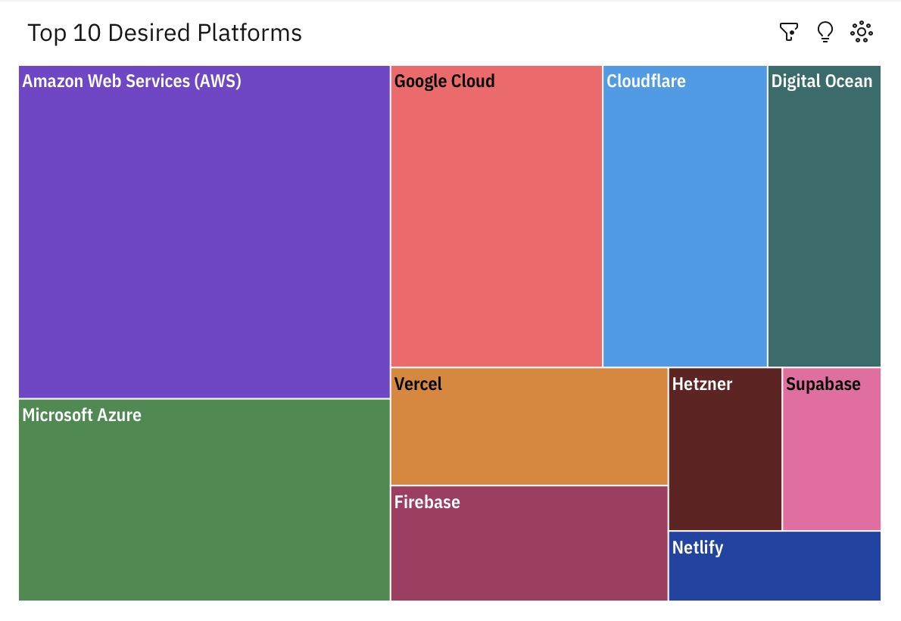
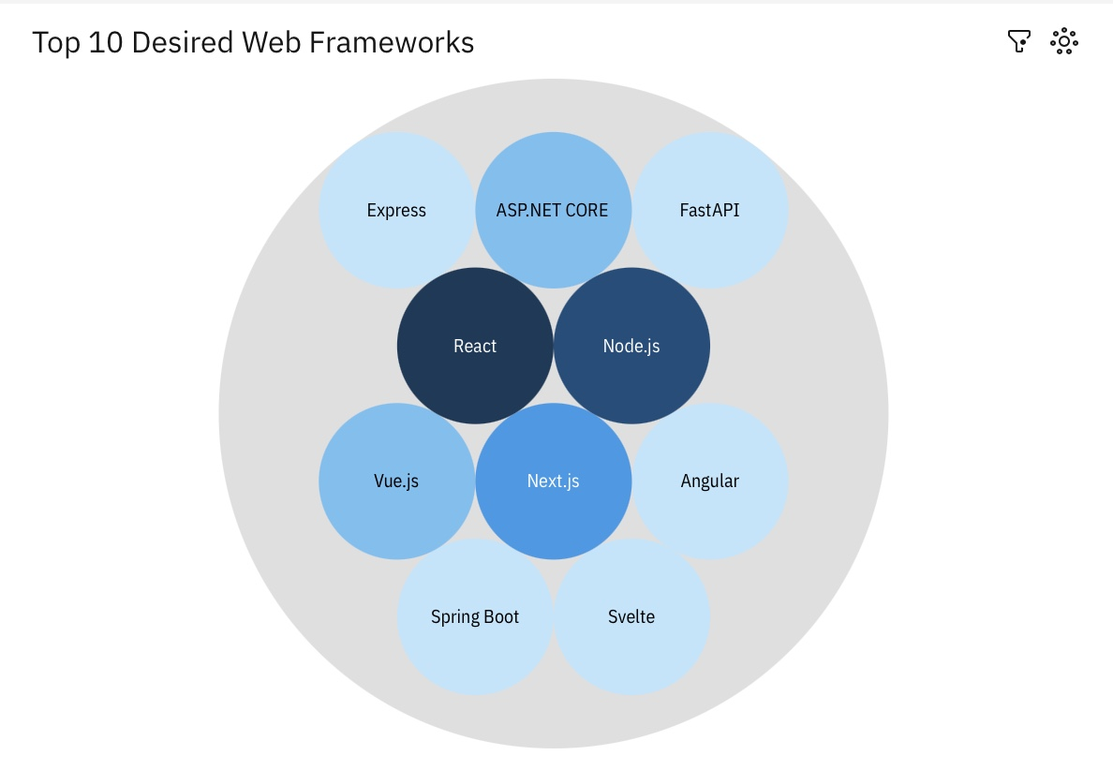
DASHBOARD TAB 2: Future Technology Trends
Screenshot of dashboard tab 2 goes here
Dashboard Insight
Summarize future trends.

Slide 16
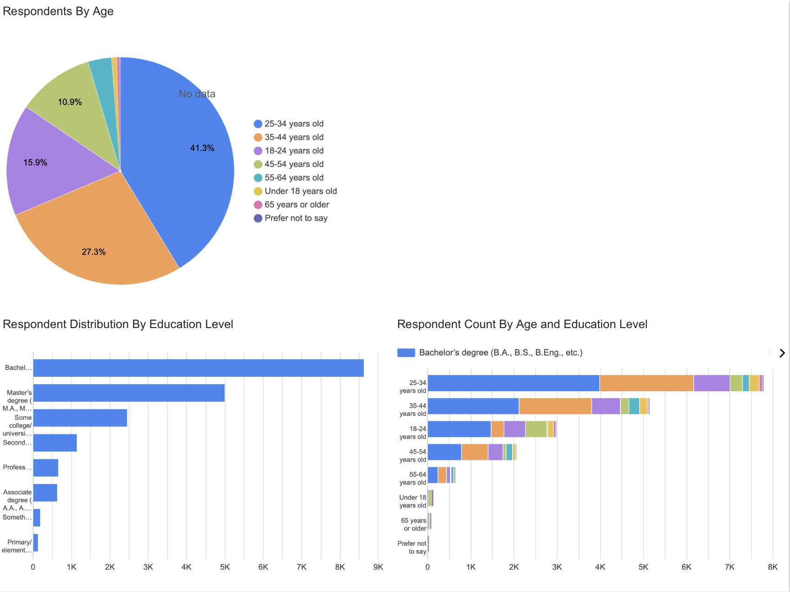
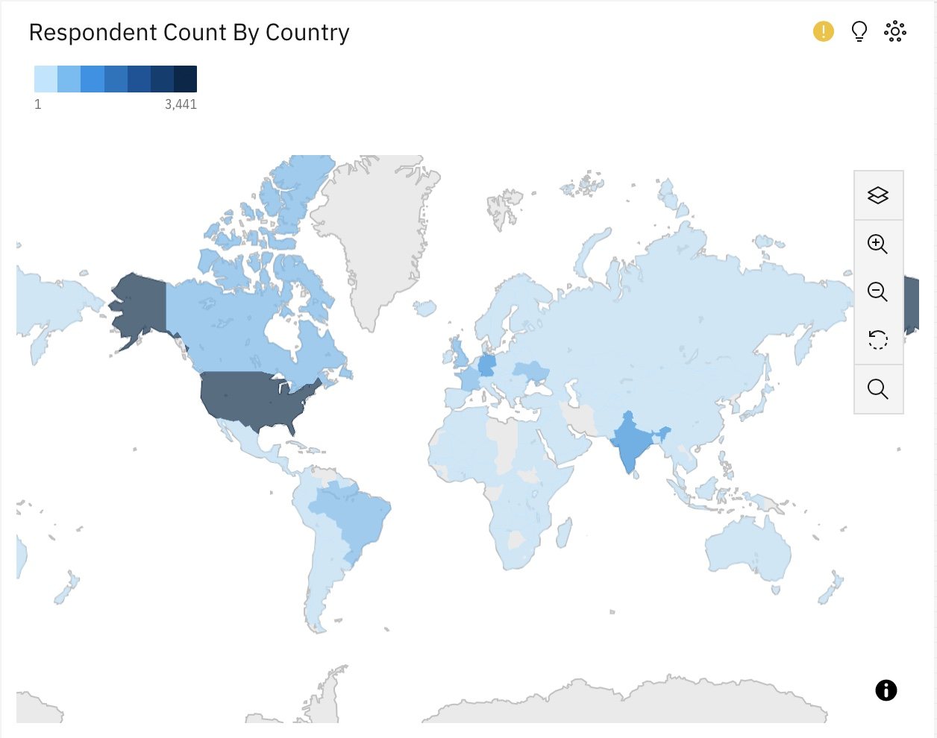
DASHBOARD TAB 3: Demographics
Screenshot of dashboard tab 3 goes here
Dashboard Insight
Summarize demographic insights

Slide 17
DISCUSSION
The technology landscape is consolidating around a small set of dominant tools such a JavaScript, PostgreSQL, AWS, and React that show no signs of being replaced.
However, a clear second wave of modern alternatives like TypeScript, Rust, Go, and Redis is rapidly gaining developer interest
The biggest shifts between current and desired usage reflect developer frustration with legacy tools.
The consistent theme across all four technology categories is that developer experience is winning. The tools gaining ground prioritize simplicity, performance, and modern ergonomics over raw feature sets or size.

Slide 18
OVERALL FINDINGS & IMPLICATIONS
FINDINGS
JavaScript, PostgreSQL, AWS, and React/Node.js are the dominant technologies across all four categories, and all maintain their top positions in both current usage and desired future adoption indicating these are deeply entrenched industry standards.
Developer demand is shifting toward modern, performance-focused languages such as TypeScript, Go, and Rust. Redis and Supabase are gaining in databases. FastAPI and Svelte are emerging in frameworks. All at the expense of older technologies like PHP, jQuery, and Oracle.
The survey population is heavily concentrated among 25–44-year-old, Bachelor's-degree-holding developers in North America and Europe, meaning these technology preferences are skewed to represent a specific demographic rather than the global developer community.
PostgreSQL is the only technology across all categories where desired usage actually exceeds current usage, suggesting it is still actively gaining adopters
IMPLICATIONS
The stability of JavaScript, PostgreSQL, AWS, and React at the top of both current and desired lists means organizations can confidently invest in these as long-term foundational technologies. They carry the lowest risk of becoming obsolete in the near future.
The consistent pattern of newer, developer-friendly tools displacing legacy technologies signals that developer experience and modern tooling are becoming key factors in technology selection. Companies sticking to older software risk falling behind in both productivity and talent acquisition.
The demographic concentration means these trends are most reliable for Western, mid-career developer teams. Companies hiring in underrepresented regions or targeting junior/senior developers should confirm these findings with local market data before making strategic decisions.
The gap between "currently using" and ”desired" across most technologies reveals a workforce eager to modernize.

Slide 19

CONCLUSION
Organizations should treat JavaScript, PostgreSQL, AWS, and React as safe long-term investments given their stability at the top of both current and desired rankings, while building internal capacity in rising technologies like TypeScript, Go, and Rust to stay competitive.
Ease of use and modern tooling are now decisive factors in technology adoption and talent retention.
Companies that proactively create opportunities for developers to work with their desired technologies will have an advantage in hiring and retaining talent.
These findings should be interpreted with the survey's demographic in mind. Organizations operating outside of North America and Europe should supplement this data with region-specific research.

